Slide 1

Sprocket Central Pty Ltd
Data analytics approach
Albader Qutub

Slide 2

Agenda
Data Exploration
Model Development
Interpretation

Slide 3
Introduction
Approach for New Customer Data analysis :
Age distribution
Bike purchase
Job industry
States & car ownership

Slide 4
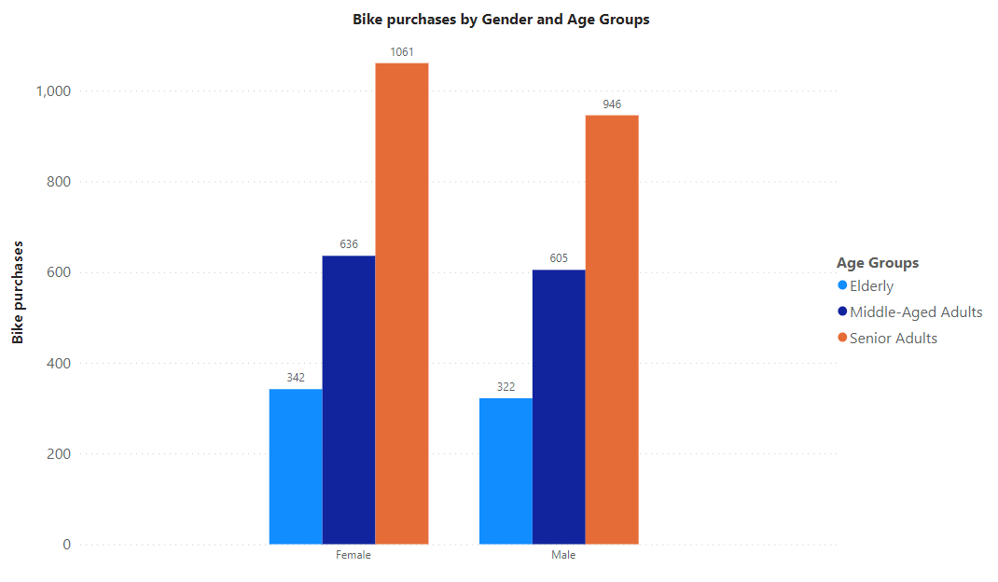
Data Exploration : Age & Bike Purchases
The data indicates that the age group between Senior Adults has the highest number of bike purchases in the last three years, with a slightly higher proportion of female buyers.
Our marketing and advertising efforts should be more focused on females than males as the primary target audience.

Slide 5
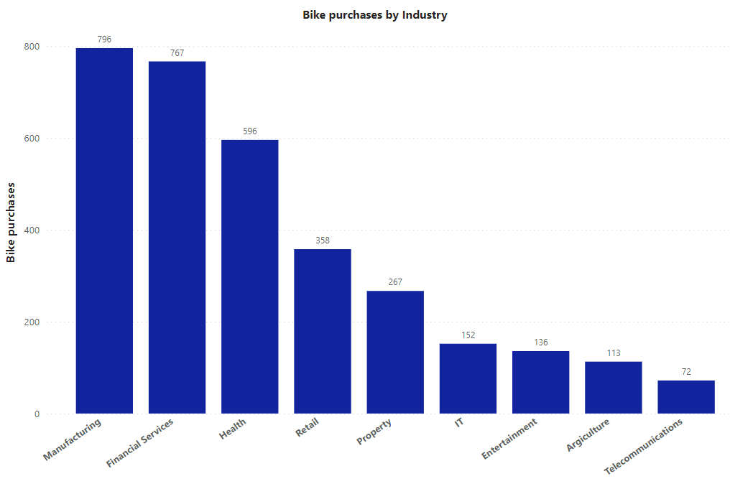
Data Exploration : Job Industry & Bike Purchases
The top three industries generating significant profits are Manufacturing, Financial Services, and Health, with Retail and Property following behind.

Slide 6
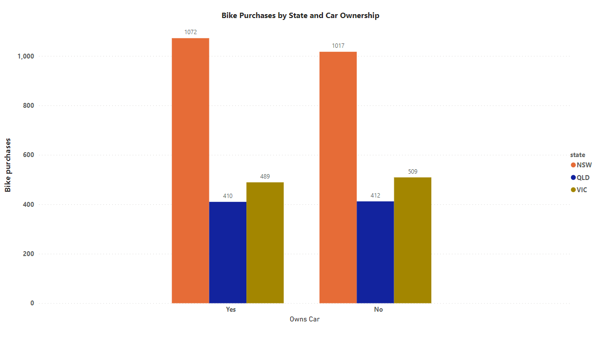
Data Exploration : Bike Purchases by States & car ownership
The data indicates that car ownership has a minimal impact on the number of purchases and among the three states, New South Wales presents potential market opportunities for the company.

Slide 7
Model Development
CUSTOMER CLASSIFICATION – Targeting High Value
Here are the high-value clients to focus on from the new list :
Senior Adults age group.
Most of the high value customers are female compared to male
Working in Financial Service, Manufacturing and Health.
Who are currently living in New South Wales and Victoria.

Slide 8
Interpretation
High-Value Client Demographic: Our target demographic for high-value clients primarily falls within the Senior Adults age group.
Gender Distribution: It's noteworthy that the majority of these high-value clients are female, indicating a potential gender-related trend or preference within this age group.
Key Industries: Our analysis identifies that a significant portion of these high-value clients are employed in the Financial Service, Manufacturing, and Health sectors, highlighting these industries as prime areas for business focus and service offerings.
Geographic Focus: Geographically, a substantial number of these high-value clients reside in New South Wales and Victoria. This geographic concentration suggests that our marketing and outreach efforts should prioritize these regions for maximum impact.

Slide 9
THANK YOU

